Slide 1
Data Analytics (CS3203N)
Lecture #8
Relation Analysis

Slide 2

Quote of the day..
Nothing great was ever achieved without enthusiasm.
Ralph Waldo Emerson, American philosopher

Slide 3

This presentation includes…
Introduction
Measures of Relationship
Correlation Analysis
$χ^{2}$- Test
Spearman’s Correlation Analysis
Pearson’s Correlation Analysis
Regression Analysis
Simple Linear Regression
Multiple Linear Regression
Non-Linear Regression Analysis
Auto-Regression Analysis

Slide 4
Hypothesis Testing Strategies
There are two types of tests of hypotheses
Parametric tests (also called standard test of hypotheses).
Non-parametric tests (also called distribution-free test of hypotheses)

Slide 5
Parametric Tests : Applications
Usually assume certain properties of the population from which we draw samples.
Observation come from a normal population
Sample size is small
Population parameters like mean, variance, etc. are hold good.
Requires measurement equivalent to interval scaled data.

Slide 6
Hypothesis Testing : Non-Parametric Test
Non-Parametric tests
Does not under any assumption
Assumes only nominal or ordinal data
Note: Non-parametric tests need entire population (or very large sample size)

Slide 7
Relationship Analysis
Example: Wage Data
A large data regarding the wages for a group of employees from the eastern region of India is given.
In particular, we wish to understand the following relationships:
Employee’s age and wage: How wages vary with ages?
Calendar year and wage: How wages vary with time?
Employee’s age and education: Whether wages are anyway related with employees’ education levels?

Slide 8
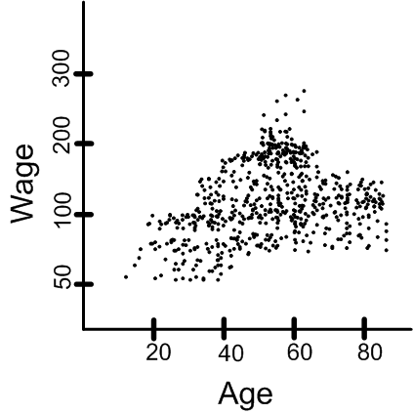
Relationship Analysis
Example: Wage Data
Case I. Wage versus Age
From the data set, we have a graphical representations, which is as follows:
How wages vary with ages?
?
How wages vary with ages?

Slide 9
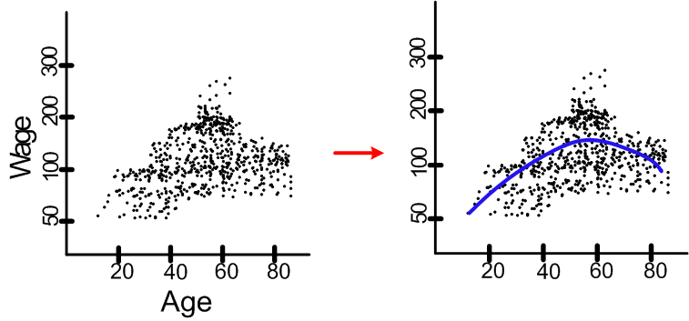
Relationship Analysis
Example: Wage Data
Employee’s age and wage: How wages vary with ages?
Interpretation: On the average, wage increases with age until about 60 years of age, at which point it begins to decline.

Slide 10
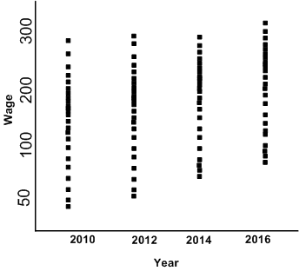
Relationship Analysis
Example: Wage Data
Case II. Wage versus Year
From the data set, we have a graphical representations, which is as follows:
?
How wages vary with time?

Slide 11
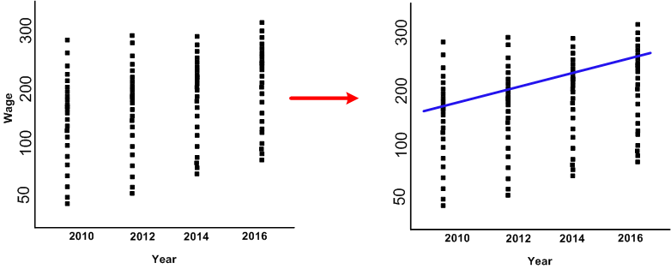
Relationship Analysis
Example: Wage Data
Wage and calendar year: How wages vary with years?
Interpretation: There is a slow but steady increase in the average wage between 2010 and 2016.
.

Slide 12
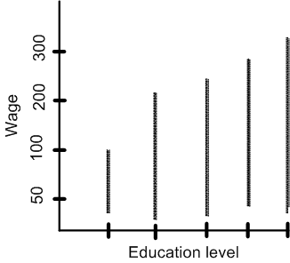
Relationship Analysis
Example: Wage Data
Case III. Wage versus Education
From the data set, we have a graphical representations, which is as follows:
?
Whether wages are related with education?

Slide 13
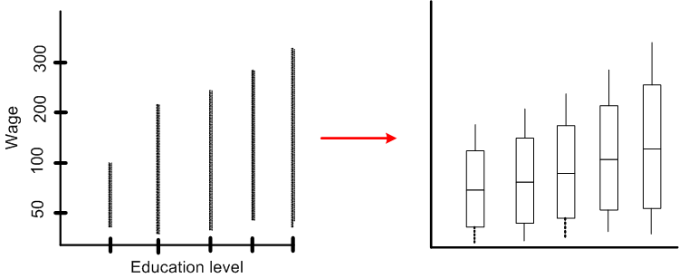
Relationship Analysis
Example: Wage Data
Wage and education level: Whether wages vary with employees’ education levels?
Interpretation: On the average, wage increases with the level of education.

Slide 14
Relationship Analysis
Given an employee’s wage can we predict his age?
Whether wage has any association with both year and education level?
etc….

Slide 15

An Open Challenge!
Suppose there are countably infinite points in the $XY plane$. We need a huge memory to store all such points.
Is there any way out to store this information with a least amount of memory?
Say, with two values only.

Slide 16
Yahoo!
Just decide the values of a and b
(as if storing one point’s data only!)
Note: Here, tricks was to find a relationship among all the points.

Slide 17
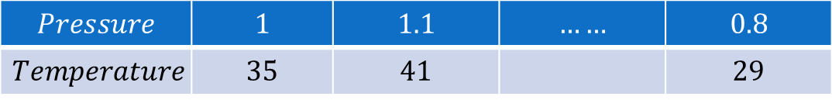
Measures of Relationship
Univariate population: The population consisting of only one variable.
Here, statistical measures are suffice to find a relationship.
Bivariate population: Here, the data happen to be on two variables.
$$Temperature$$ | $$20$$ | $$30$$ | $$21$$ | $$18$$ | $$23$$ | $$45$$ | $$52$$
$$Pressure$$ | $$1$$ | $$1.1$$ | $$……$$ | $$0.8$$
$$Temperature$$ | $$35$$ | $$41$$ |  | $$29$$

Slide 18
Measures of Relationship
Multivariate population: If the data happen to be one more than two variable.
? If we add another variable say viscosity in addition to Pressure, Volume or Temperature?

Slide 19
Measures of Relationship
In case of bivariate and multivariate populations, usually, we have to answer two types of questions:
Q1: Does there exist correlation (i.e., association) between two (or more) variables?
If yes, of what degree?
Q2: Is there any cause and effect relationship between the two variables (in case of bivariate population) or one variable in one side and two or more variables on the other side (in case of multivariate population)?
If yes, of what degree and in which direction?
To find solutions to the above questions, two approaches are known.
Correlation Analysis
Regression Analysis

Slide 20
Correlation Analysis

Slide 21
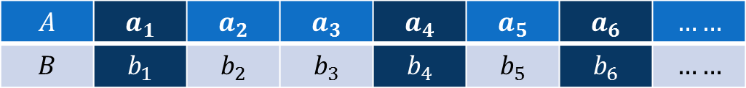
Correlation Analysis
In statistics, the word correlation is used to denote some form of association between two variables.
Example: Weight is correlated with height
Example:
The correlation may be positive, negative or zero.
Positive correlation: If the value of the attribute A increases with the increase in the value of the attribute B and vice-versa.
Negative correlation: If the value of the attribute A decreases with the increase in the value of the attribute B and vice-versa.
Zero correlation: When the values of attribute A varies at random with B and vice-versa.
$$A$$ | $$a_{1}$$ | $$a_{2}$$ | $$a_{3}$$ | $$a_{4}$$ | $$a_{5}$$ | $$a_{6}$$ | $$……$$
$$B$$ | $$b_{1}$$ | $$b_{2}$$ | $$b_{3}$$ | $$b_{4}$$ | $$b_{5}$$ | $$b_{6}$$ | $$……$$

Slide 22
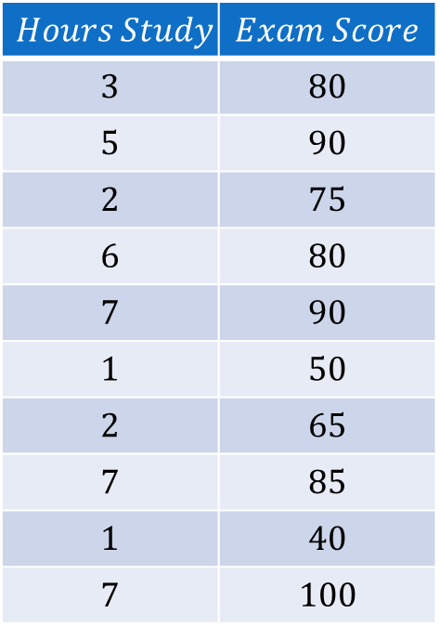
Correlation Analysis
In order to measure the degree of correlation between two attributes.
$$Hours Study$$ | $$Exam Score$$
$$3$$ | $$80$$
$$5$$ | $$90$$
$$2$$ | $$75$$
$$6$$ | $$80$$
$$7$$ | $$90$$
$$1$$ | $$50$$
$$2$$ | $$65$$
$$7$$ | $$85$$
$$1$$ | $$40$$
$$7$$ | $$100$$

Slide 23
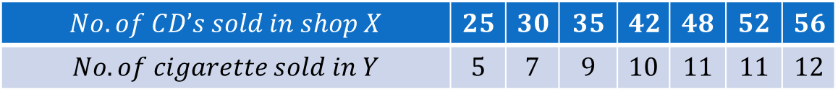
Correlation Analysis
Do you find any correlation between X and Y as shown in the table?.
Note:
In data analytics, correlation analysis make sense only when relationship make sense.
There should be a cause-effect relationship.
$$No. of CD’s sold in shop X$$ | $$25$$ | $$30$$ | $$35$$ | $$42$$ | $$48$$ | $$52$$ | $$56$$
$$No. of cigarette sold in Y$$ | $$5$$ | $$7$$ | $$9$$ | $$10$$ | $$11$$ | $$11$$ | $$12$$

Slide 24
Correlation Analysis

Slide 25
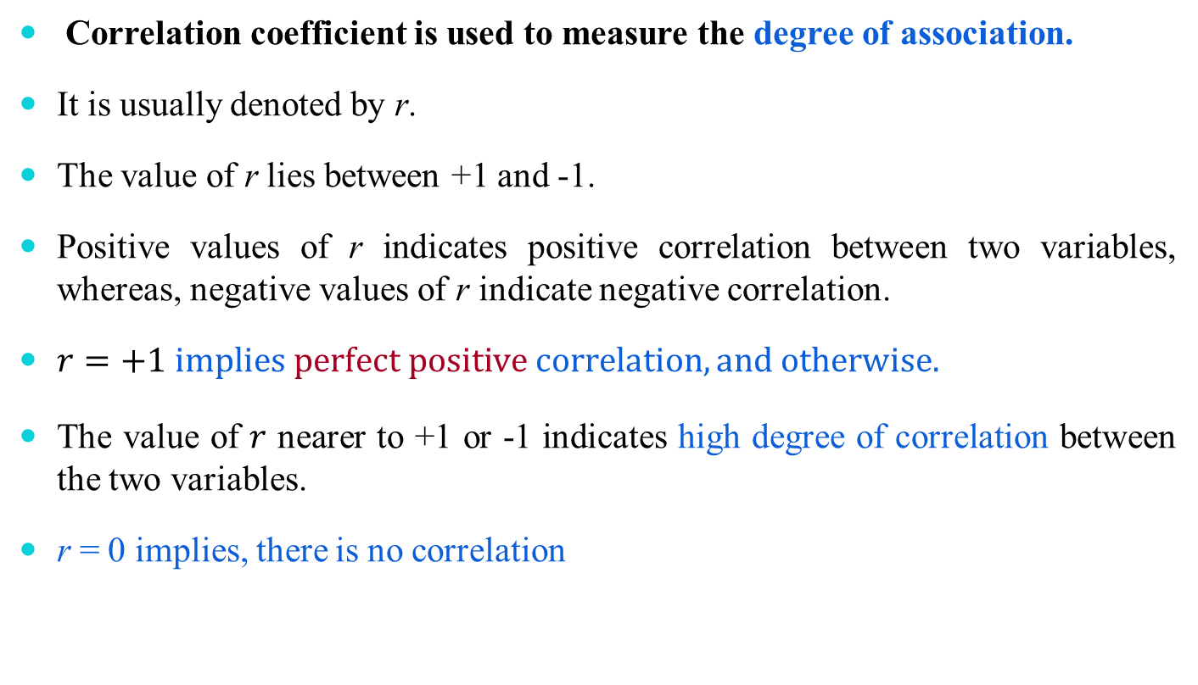
Correlation Coefficient
Correlation coefficient is used to measure the degree of association.
It is usually denoted by r.
The value of r lies between +1 and -1.
Positive values of r indicates positive correlation between two variables, whereas, negative values of r indicate negative correlation.
$r=+1 implies perfect positive correlation, and otherwise.$
The value of $r$ nearer to +1 or -1 indicates high degree of correlation between the two variables.
r = 0 implies, there is no correlation

Slide 26
Correlation Coefficient

Slide 27
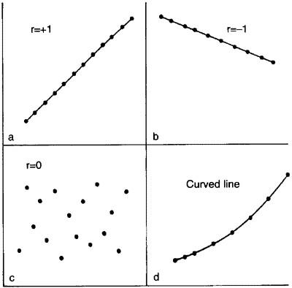
Correlation Coefficient

Slide 28
Correlation Coefficient

Slide 29
Measuring Correlation Coefficients
There are three methods known to measure the correlation coefficients
Karl Pearson’s coefficient of correlation
This method is applicable to find correlation coefficient between two numerical attributes
Charles Spearman’s coefficient of correlation
This method is applicable to find correlation coefficient between two ordinal attributes
Chi-square coefficient of correlation
This method is applicable to find correlation coefficient between two categorical attributes

Slide 30
Pearson’s Correlation Coefficient

Slide 31

Karl Pearson’s Correlation Coefficient
This is also called Pearson’s Product Moment Correlation
Let us consider two attributes are X and Y.
The Karl Pearson’s coefficient of correlation is denoted by 𝑟∗ and is defined as
$$r^{∗}=\frac{\sum{(X_{i}−\overline{X})(Y_{i}−\overline{Y})}}{σ_{X}.σ_{Y}}$$
where $X_{i}=i−th value of X−variable$
$\overline{X}=mean of X$
$$Y_{i}=i−th value of Y−variable$$
$$\overline{Y}=mean of Y$$
$$n=number of pairs of observation of X and Y$$
$$σ_{X}=standard deviations of X$$
$$σ_{Y}=standard deviation of Y$$
Definition 7.1: Karl Pearson’s correlation coefficient

Slide 32
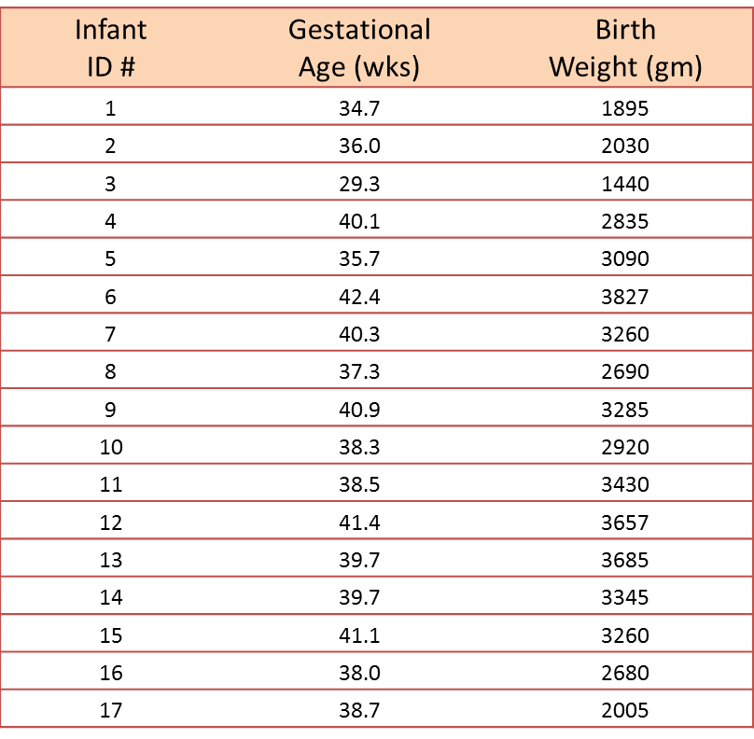
Karl Pearson’s coefficient of Correlation
Example 7.1: Correlation of Gestational Age and Birth Weight
A small study is conducted involving 17 infants to investigate the association between gestational age at birth, measured in weeks, and birth weight, measured in grams.

Slide 33
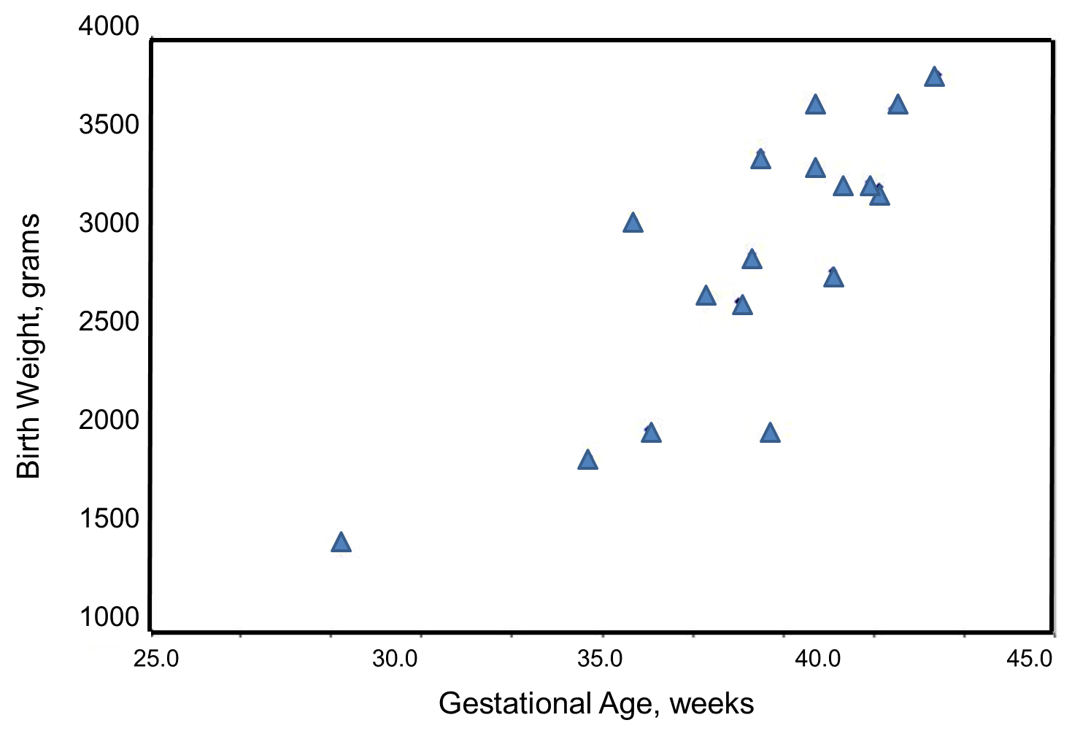
Karl Pearson’s coefficient of Correlation
Example 7.1: Correlation of Gestational Age and Birth Weight
We wish to estimate the association between gestational age and infant birth weight.
In this example, birth weight is the dependent variable and gestational age is the independent variable. Thus Y = birth weight and X = gestational age.
The data are displayed in a scatter diagram in the figure below.

Slide 34




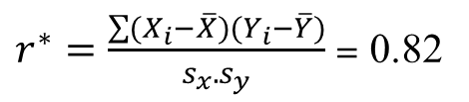
Karl Pearson’s coefficient of Correlation
Example 7.1: Correlation of Gestational Age and Birth Weight
For the given data, it can be shown the following
$r^{∗}=\frac{\sum{(X_{i}−\overline{X})(Y_{i}−\overline{Y})}}{s_{x}.s_{y}}$ = 0.82
Conclusion: The sample’s correlation coefficient indicates a strong positive correlation between Gestational Age and Birth Weight.

Slide 35
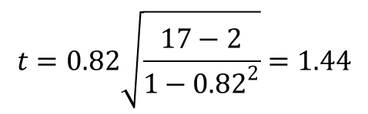
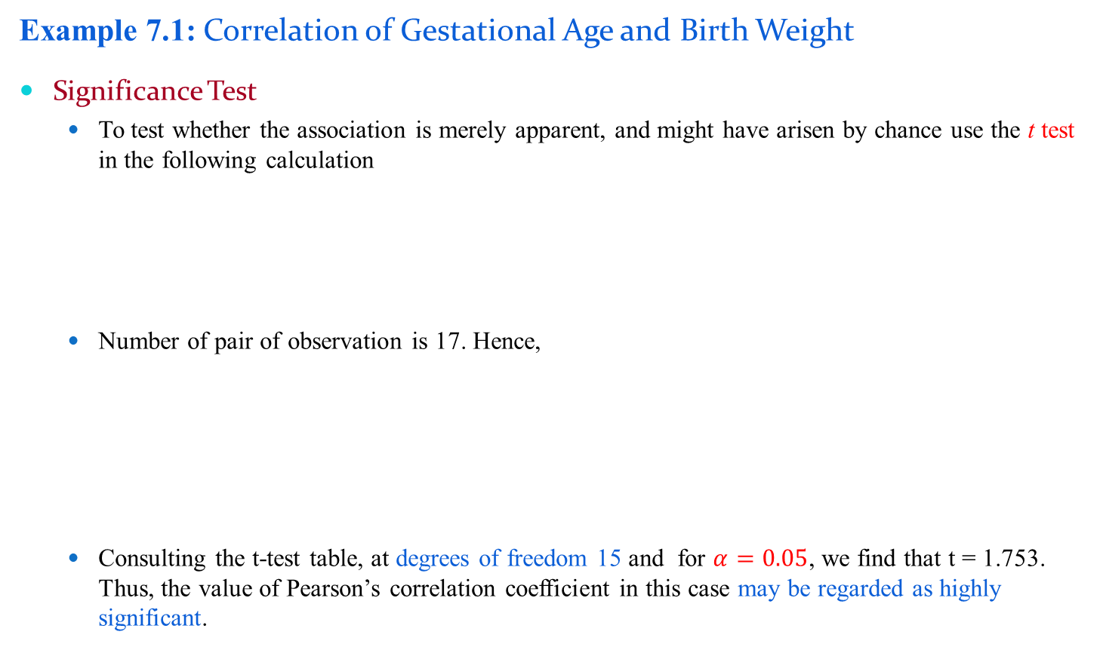
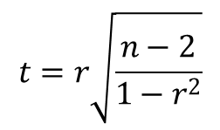
Karl Pearson’s coefficient of Correlation
Example 7.1: Correlation of Gestational Age and Birth Weight
Significance Test
To test whether the association is merely apparent, and might have arisen by chance use the t test in the following calculation
Number of pair of observation is 17. Hence,
Consulting the t-test table, at degrees of freedom 15 and for $α=0.05$, we find that t = 1.753. Thus, the value of Pearson’s correlation coefficient in this case may be regarded as highly significant.
$$t=r\sqrt{\frac{n−2}{1−r^{2}}}$$
$$t=0.82\sqrt{\frac{17−2}{1−{0.82}^{2}}}=1.44$$

Slide 36
Rank Correlation Coefficient

Slide 37
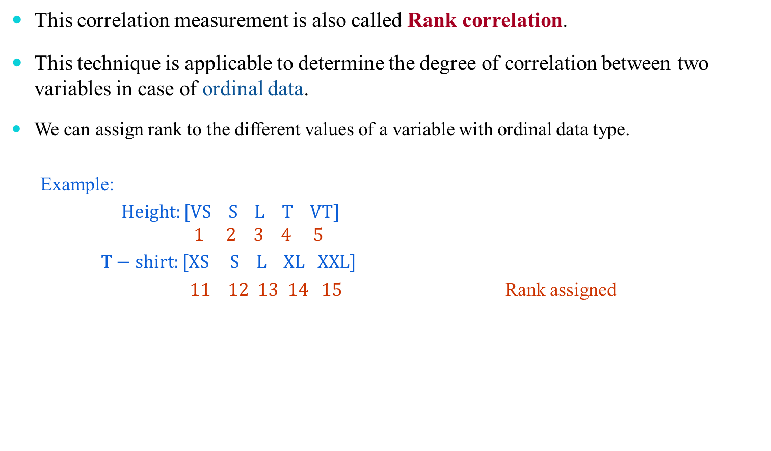
Charles Spearman’s Correlation Coefficient
This correlation measurement is also called Rank correlation.
This technique is applicable to determine the degree of correlation between two variables in case of ordinal data.
We can assign rank to the different values of a variable with ordinal data type.
Example:
$Height:[VS S L T VT]$
$$1 2 3 4 5$$
$T−shirt:[XS S L XL XXL]$
$11 12 13 14 15$ Rank assigned

Slide 38
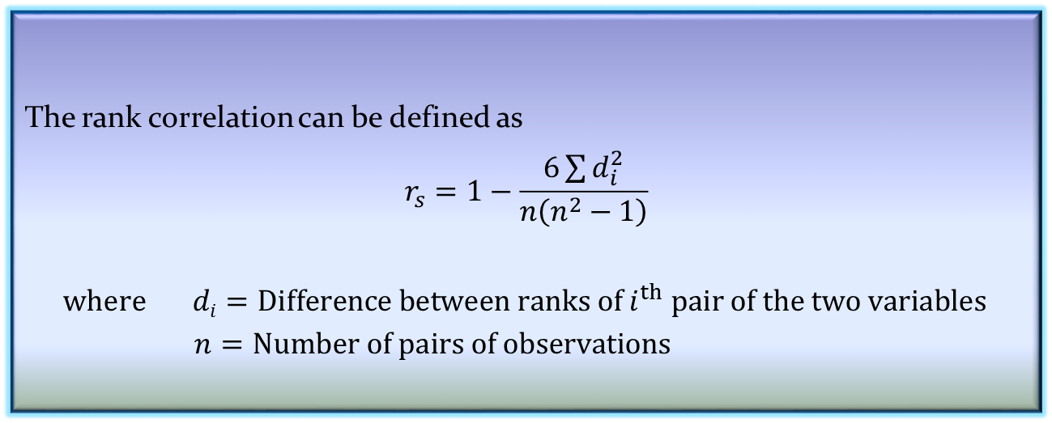
Charles Spearman’s Correlation Coefficient
The Spearman’s coefficient is often used as a statistical methods to aid either providing or disproving a hypothesis.
The rank correlation can be defined as
$$r_{s}=1−\frac{6\sum{d_{i}^{2}}}{n\left(n^{2}−1\right)}$$
$$where di=Difference between ranks of i^{th} pair of the two variables$$
$n=Number of pairs of observations$
Definition 7.2: Charles Spearman’s correlation coefficient

Slide 39
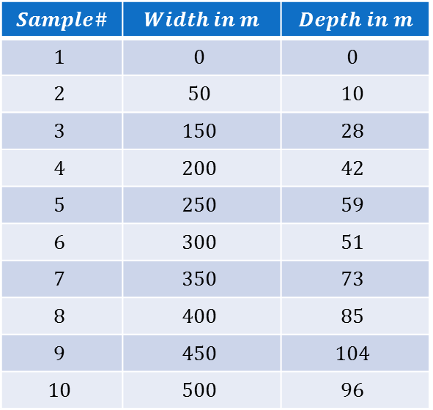
Charles Spearman’s Coefficient of Correlation
Example 7.2: The hypothesis that the depth of a river does not progressively increase with the width of the river.
A sample of size 10 is collected to test the hypothesis, using Spearman’s correlation coefficient.
$$Sample\#$$ | $$Width in m$$ | $$Depth in m$$
$$1$$ | $$0$$ | $$0$$
$$2$$ | $$50$$ | $$10$$
$$3$$ | $$150$$ | $$28$$
$$4$$ | $$200$$ | $$42$$
$$5$$ | $$250$$ | $$59$$
$$6$$ | $$300$$ | $$51$$
$$7$$ | $$350$$ | $$73$$
$$8$$ | $$400$$ | $$85$$
$$9$$ | $$450$$ | $$104$$
$$10$$ | $$500$$ | $$96$$

Slide 40
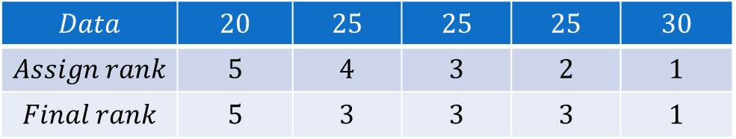
Charles Spearman’s Coefficient of Correlation
Step 1: Assign rank to each data. It is customary to assign rank 1 to the largest data, and 2 to next largest and so on.
Note: If there are two or more samples with the same value, the mean rank should be used.
$$Data$$ | $$20$$ | $$25$$ | $$25$$ | $$25$$ | $$30$$
$$Assign rank$$ | $$5$$ | $$4$$ | $$3$$ | $$2$$ | $$1$$
$$Final rank$$ | $$5$$ | $$3$$ | $$3$$ | $$3$$ | $$1$$

Slide 41

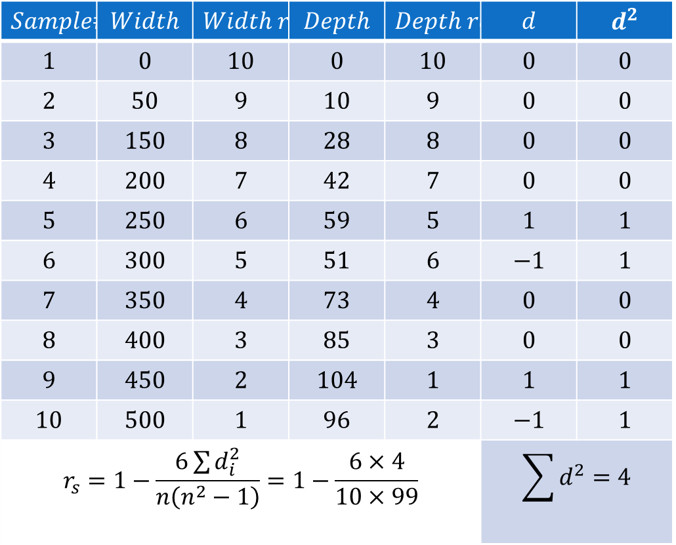
Charles Spearman’s Coefficient of Correlation
Step 2: The contingency table will look like
$$Sample\#$$ | $$Width$$ | $$Width rank$$ | $$Depth$$ | $$Depth rank$$ | $$d$$ | $$d^{2}$$
$$1$$ | $$0$$ | $$10$$ | $$0$$ | $$10$$ | $$0$$ | $$0$$
$$2$$ | $$50$$ | $$9$$ | $$10$$ | $$9$$ | $$0$$ | $$0$$
$$3$$ | $$150$$ | $$8$$ | $$28$$ | $$8$$ | $$0$$ | $$0$$
$$4$$ | $$200$$ | $$7$$ | $$42$$ | $$7$$ | $$0$$ | $$0$$
$$5$$ | $$250$$ | $$6$$ | $$59$$ | $$5$$ | $$1$$ | $$1$$
$$6$$ | $$300$$ | $$5$$ | $$51$$ | $$6$$ | $$−1$$ | $$1$$
$$7$$ | $$350$$ | $$4$$ | $$73$$ | $$4$$ | $$0$$ | $$0$$
$$8$$ | $$400$$ | $$3$$ | $$85$$ | $$3$$ | $$0$$ | $$0$$
$$9$$ | $$450$$ | $$2$$ | $$104$$ | $$1$$ | $$1$$ | $$1$$
$$10$$ | $$500$$ | $$1$$ | $$96$$ | $$2$$ | $$−1$$ | $$1$$
$$r_{s}=1−\frac{6\sum{d_{i}^{2}}}{n\left(n^{2}−1\right)}=1−\frac{6×4}{10×99}$$ |  |  |  |  | $$\sum{d^{2}=4}$$
$$r_{s}=0.9757$$

Slide 42

Charles Spearman’s Coefficient of Correlation
Step 3: To see, if this $r_{s}$ value is significant, the Spearman’s rank significance table (or
graph) must be consulted.
Note: $The degrees of freedom for the sample=n−2=8$
$$Assume, the significance level=0.1\%$$
Spearaman’s rank correlation coefficient

Slide 43
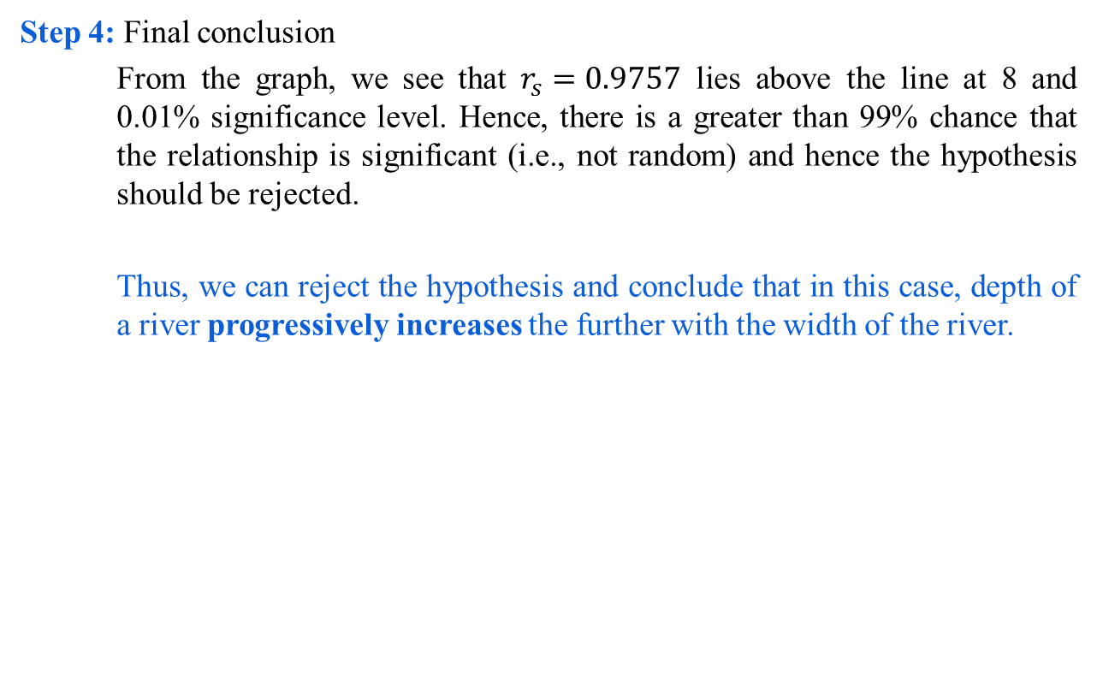
Charles Spearman’s Coefficient of Correlation
Step 4: Final conclusion
From the graph, we see that $r_{s}=0.9757$ lies above the line at 8 and 0.01% significance level. Hence, there is a greater than 99% chance that the relationship is significant (i.e., not random) and hence the hypothesis should be rejected.
Thus, we can reject the hypothesis and conclude that in this case, depth of a river progressively increases the further with the width of the river.

Slide 44
χ2-Correlation Analysis

Slide 45
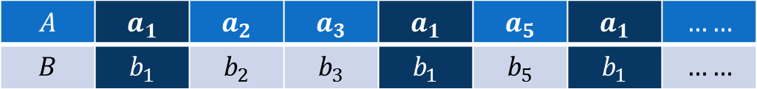
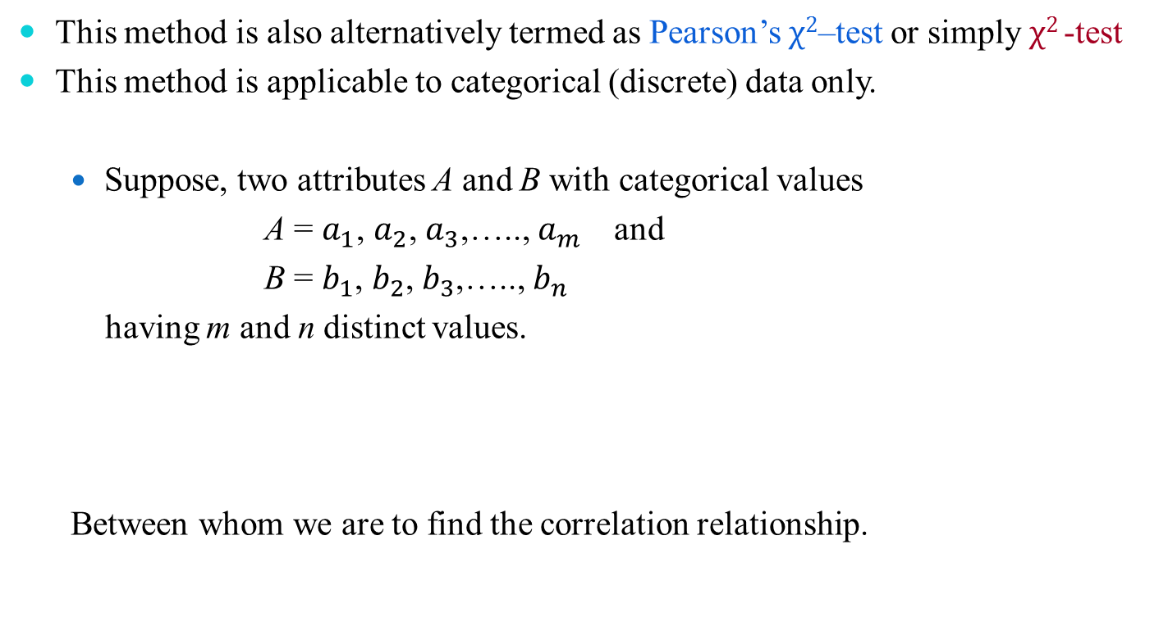
Chi-Squared Test of Correlation
This method is also alternatively termed as Pearson’s $χ2$–test or simply $χ2$-test
This method is applicable to categorical (discrete) data only.
Suppose, two attributes A and B with categorical values
A = $a_{1}$, $a_{2}$, $a_{3}$,….., $a_{m }$ and
B = $b_{1}$, $b_{2}$, $b_{3}$,….., $b_{n }$
having m and n distinct values.
Between whom we are to find the correlation relationship.
$$A$$ | $$a_{1}$$ | $$a_{2}$$ | $$a_{3}$$ | $$a_{1}$$ | $$a_{5}$$ | $$a_{1}$$ | $$……$$
$$B$$ | $$b_{1}$$ | $$b_{2}$$ | $$b_{3}$$ | $$b_{1}$$ | $$b_{5}$$ | $$b_{1}$$ | $$……$$

Slide 46
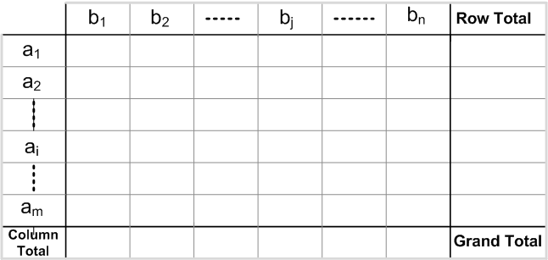
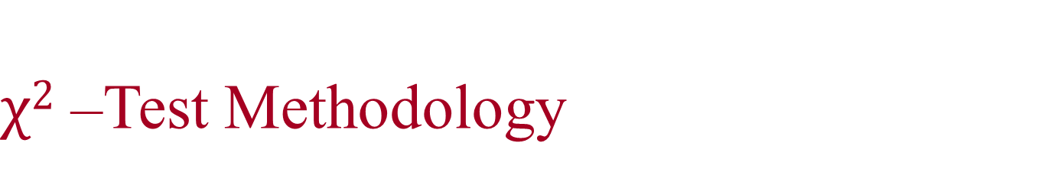
$χ2$ –Test Methodology
Contingency Table
Given a data set, it is customary to draw a contingency table, whose structure is given below.

Slide 47
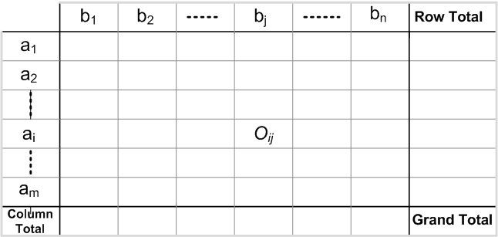
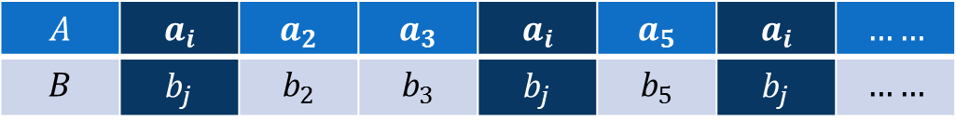
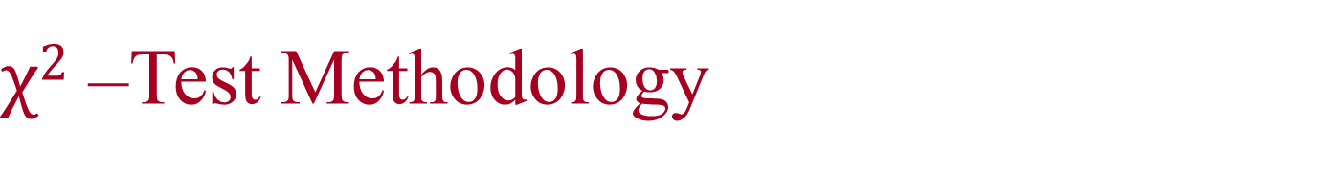
$χ2$ –Test Methodology
Entry into Contingency Table: Observed Frequency
In contingency table, an entry O_{ij} denotes the event that attribute A takes on value a_{i} and attribute B takes on value b_{j} (i.e., A = a_{i}, B = b_{j}).
$$A$$ | $$a_{i}$$ | $$a_{2}$$ | $$a_{3}$$ | $$a_{i}$$ | $$a_{5}$$ | $$a_{i}$$ | $$……$$
$$B$$ | $$b_{j}$$ | $$b_{2}$$ | $$b_{3}$$ | $$b_{j}$$ | $$b_{5}$$ | $$b_{j}$$ | $$……$$

Slide 48
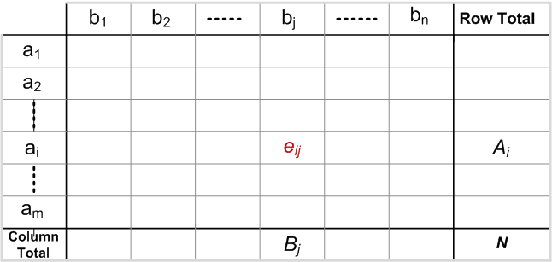

$χ2$ –Test Methodology
Entry into Contingency Table: Expected Frequency
In contingency table, an entry e_{ij} denotes the expected frequency, which can be calculated as
$$e_{ij}=\frac{Count(A=a_{i})×Count(B=b_{j})}{Grand Total}=\frac{A_{i}×B_{j}}{N}$$

Slide 49
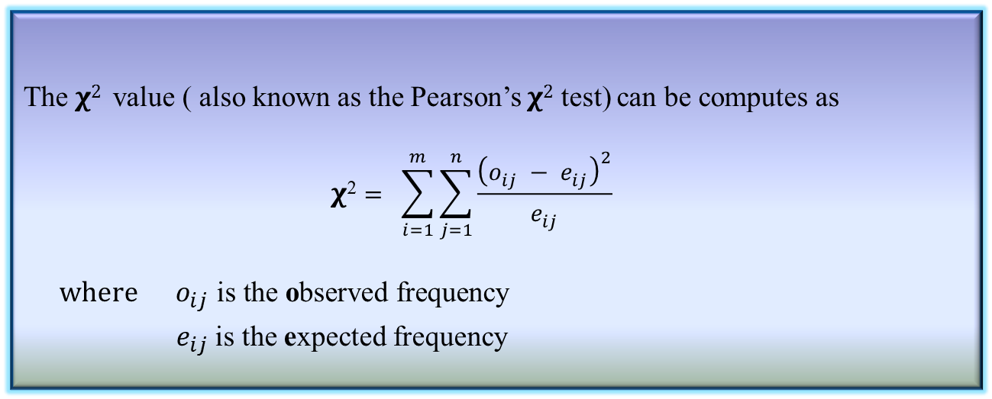
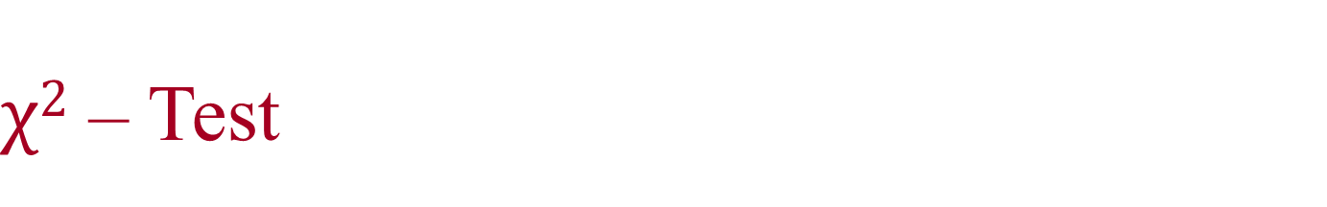
$χ2$ – Test
The $χ2$ value ( also known as the Pearson’s $χ2$ test) can be computes as
$$\text{χ}\text{2}= \sum_{i=1}^{m}{\sum_{j=1}^{n}{\frac{{\left(o_{ij} − e_{ij}\right)}^{2}}{e_{ij}}}}$$
$$where{ o}_{ij} \text{is} \text{the} \text{o}\text{bserved} \text{frequency}$$
${ e}_{ij}$ is the expected frequency
Definition 7.3: χ²-Value

Slide 50
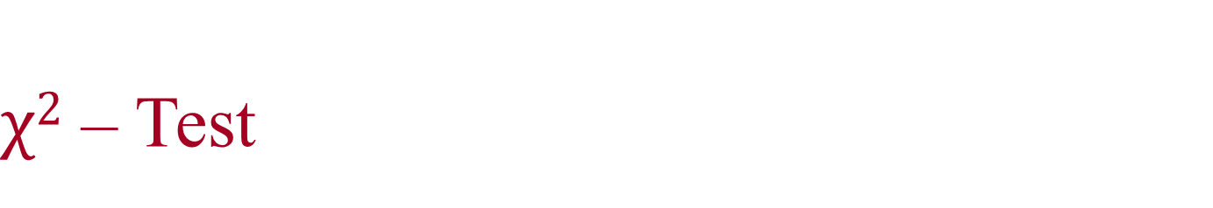
$χ2$ – Test
The cell that contribute the most to the 𝛘² value are those whose actual count is very different from the expected.
The 𝛘² statistics tests the hypothesis that A and B are independent. The test is based on a significance level, with (n-1) ×(m-1) degrees of freedom., with a contingency table of size n×m
If the hypothesis can be rejected, then we say that A and B are statistically related or associated.

Slide 51
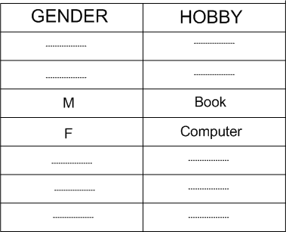
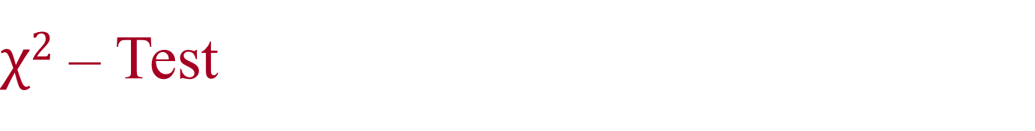
$χ2$ – Test
Example 7.3: Survey on Gender versus Hobby.
Suppose, a survey was conducted among a population of size 1500. In this survey, gender of each person and their hobby as either “book” or “computer” was noted. The survey result obtained in a table like the following.
We have to find if there is any association between Gender and Hobby of a people, that is, we are to test whether “gender” and “hobby” are correlated.

Slide 52
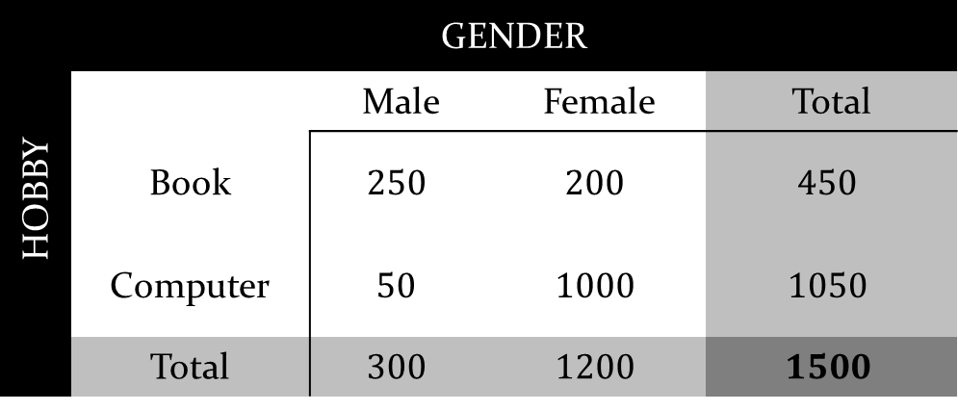
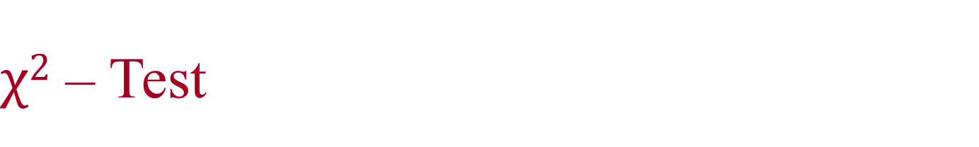
$χ2$ – Test
Example 7.3: Survey on Gender versus Hobby.
From the survey table, the observed frequency are counted and entered into the contingency table, which is shown below.
HOBBY | GENDER
 |  | Male | Female | Total
 | Book | $$250$$ | $$200$$ | $$450$$
 | Computer | $$50$$ | $$1000$$ | $$1050$$
 | Total | $$300$$ | $$1200$$ | $$1500$$

Slide 53
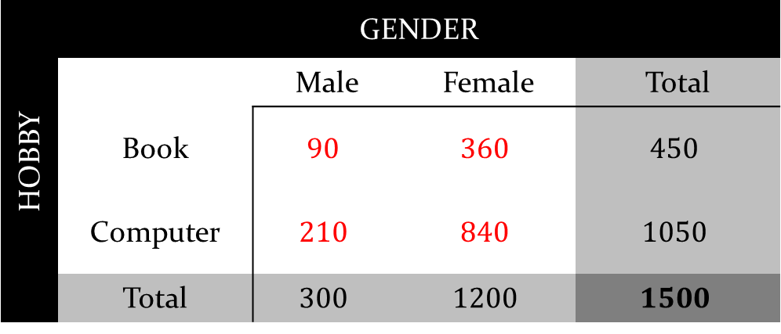
$χ2$ – Test
Example 7.3: Survey on Gender versus Hobby.
From the survey table, the expected frequency are counted and entered into the contingency table, which is shown below.
HOBBY | GENDER
 |  | Male | Female | Total
 | Book | $$90$$ | $$360$$ | $$450$$
 | Computer | $$210$$ | $$840$$ | $$1050$$
 | Total | $$300$$ | $$1200$$ | $$1500$$

Slide 54
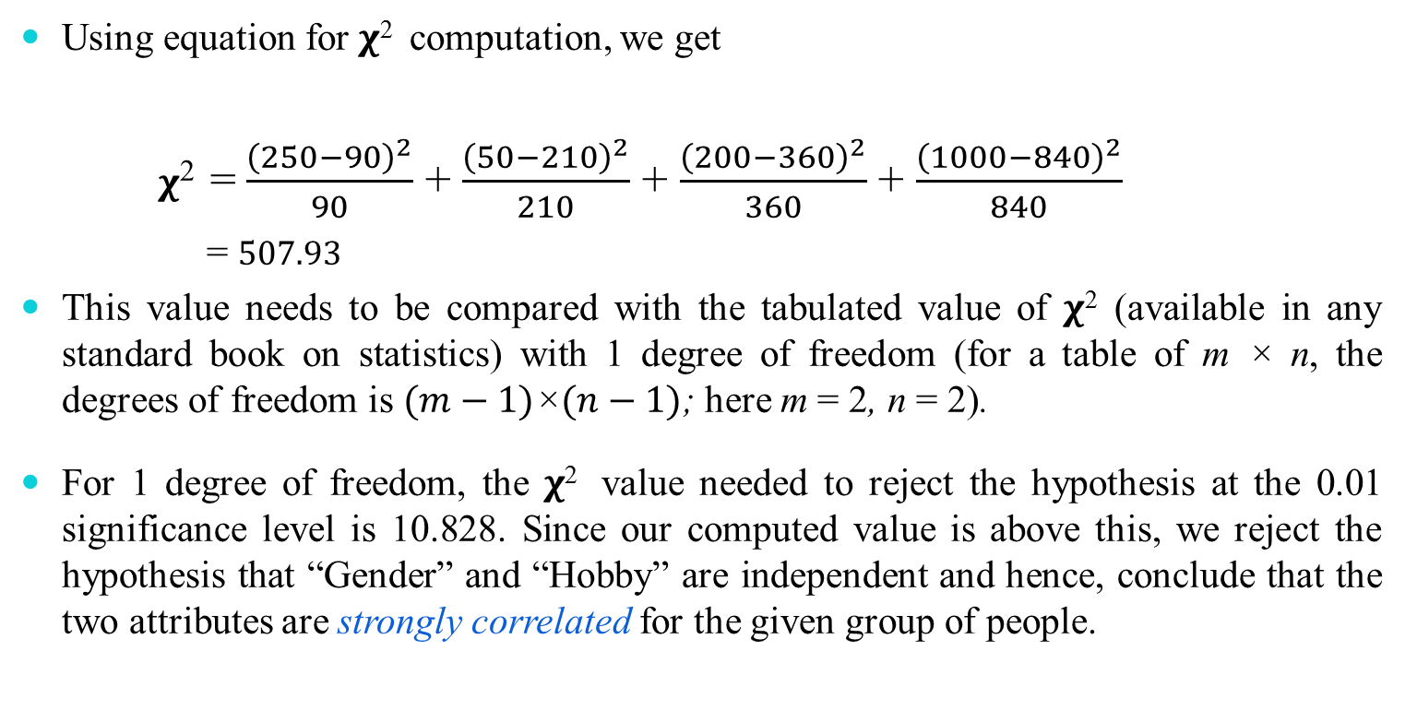

$χ2$ – Test
Using equation for 𝛘² computation, we get
𝛘² =$\frac{{\left(250−90\right)}^{2}}{90}$ + $\frac{{\left(50−210\right)}^{2}}{210}$ + $\frac{{\left(200−360\right)}^{2}}{360}$ + $\frac{{\left(1000−840\right)}^{2}}{840}$
= $507.93$
This value needs to be compared with the tabulated value of 𝛘² (available in any standard book on statistics) with 1 degree of freedom (for a table of m × n, the degrees of freedom is $(m−1)\text{×}(n−1)$; here m = 2, n = 2).
For 1 degree of freedom, the 𝛘² value needed to reject the hypothesis at the 0.01 significance level is 10.828. Since our computed value is above this, we reject the hypothesis that “Gender” and “Hobby” are independent and hence, conclude that the two attributes are strongly correlated for the given group of people.

Slide 55

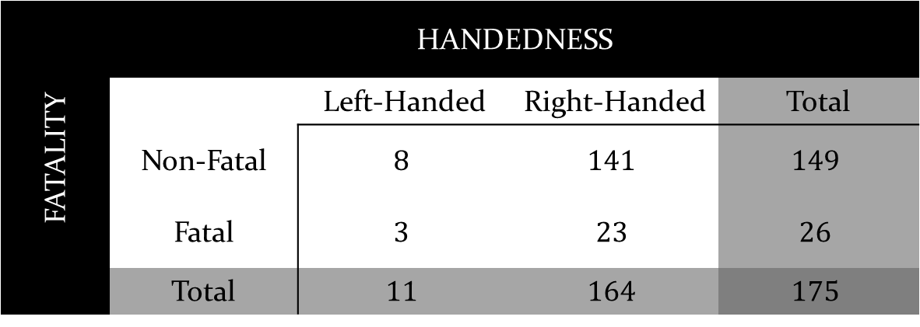
$χ2$ – Test
Example 7.4: Hypothesis on “accident proneness” versus “driver’s handedness”.
Consider the following $contingency table$ on car accidents among left and right-handed drivers’ of sample size 175.
Hypothesis is that “fatality of accidents is independent of driver’s handedness”
Find the correlation between Fatality and Handedness and test the significance of the correlation with significance level 0.1%.
FATALITY | HANDEDNESS
 |  | Left-Handed | Right-Handed | Total
 | Non-Fatal | $$8$$ | $$141$$ | $$149$$
 | Fatal | $$3$$ | $$23$$ | $$26$$
 | Total | $$11$$ | $$164$$ | $$175$$

Slide 56
Regression Analysis

Slide 57
Regression Analysis
The regression analysis is a statistical method to deal with the formulation of mathematical model depicting relationship amongst variables, which can be used for the purpose of prediction of the values of dependent variable, given the values of independent variables.
Classification of Regression Analysis Models
Linear regression models
Simple linear regression
Multiple linear regression
Non-linear regression models

Slide 58
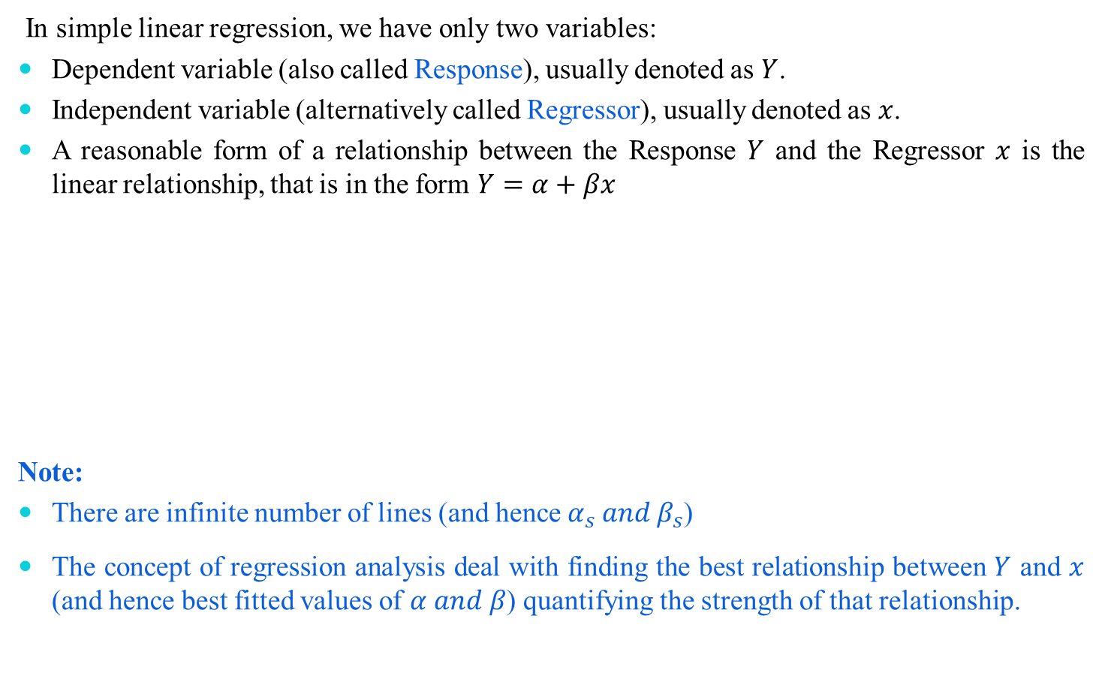
Simple Linear Regression Model
In simple linear regression, we have only two variables:
Dependent variable (also called Response), usually denoted as $Y$.
Independent variable (alternatively called Regressor), usually denoted as $x$.
A reasonable form of a relationship between the Response $Y$ and the Regressor $x$ is the linear relationship, that is in the form $Y=α+βx$
Note:
There are infinite number of lines (and hence $α_{s} and β_{s}$)
The concept of regression analysis deal with finding the best relationship between $Y$ and $x$ (and hence best fitted values of $α and β$) quantifying the strength of that relationship.

Slide 59
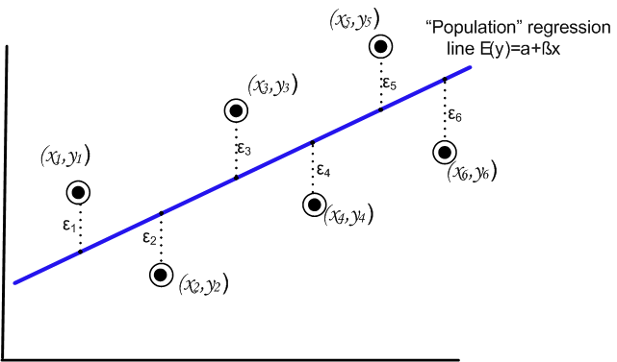
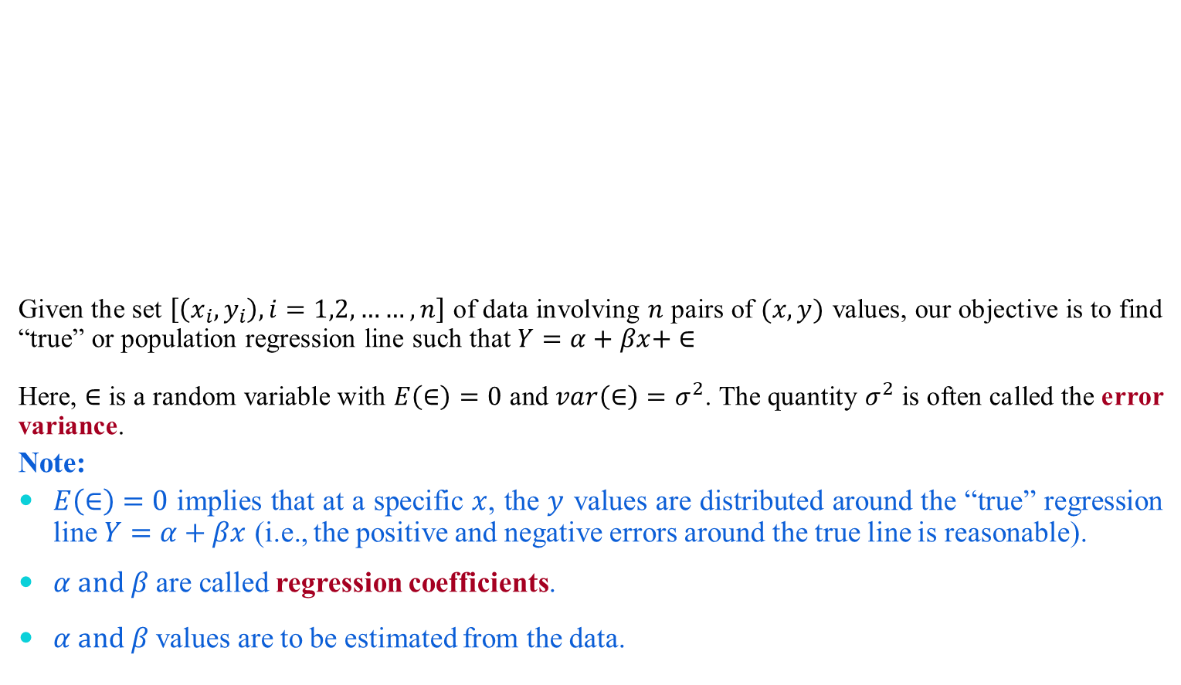
Regression Analysis
Given the set $\left[\left(x_{i},y_{i}\right), i=1,2,……,n\right]$ of data involving $n$ pairs of $(x,y)$ values, our objective is to find “true” or population regression line such that $Y=α+βx+ ∈$
Here, $∈$ is a random variable with $E\left(∈\right)=0$ and $var\left(∈\right)=σ^{2}$. The quantity $σ^{2}$ is often called the error variance.
Note:
$E\left(∈\right)=0$ implies that at a specific $x$, the $y$ values are distributed around the “true” regression line $Y=α+βx$ (i.e., the positive and negative errors around the true line is reasonable).
$α and β$ are called regression coefficients.
$α and β$ values are to be estimated from the data.

Slide 60

True versus Fitted Regression Line
The task in regression analysis is to estimate the regression coefficients $α and β$.
Suppose, we denote the estimates a for $α$ and b for $β$. Then the fitted regression line is
$\hat{Y}=a+bx$
where $\hat{Y}$is the predicted or fitted value.

Slide 61


Least Square Method to estimate $α and β$
This method uses the concept of residual. A residual is essentially an error in the fit of the model $\hat{Y}=a+bx$. Thus, $i^{th}$ residual is
$e_{i}=Y_{i}−{\hat{Y}}_{i}$, $i=1,2,3,……,n$

Slide 62

Least Square method
The residual sum of squares is often called the sum of squares of the errors about the fitted line and is denoted as SSE
SSE = $\sum_{i=1}^{n}{e_{i}^{2}}$ = $\sum_{i=1}^{n}{{(y_{i}\text{−}ŷ_{i}\text{)}}^{2}=\sum_{i=1}^{n}{{(y_{i}−a−{bxi}_{})}^{2}}}$
We are to minimize the value of SSE and hence to determine the parameters of a and b.
Differentiating SSE with respect to a and b, we have
$\frac{∂(SSE)}{∂a}=−2\sum_{i=1}^{n}{{\left(y_{i}−a−bxi\right)}^{}}$
$\frac{∂(SSE)}{∂b}=−2\sum_{i=1}^{n}{\left(y_{i}−a−bxi\right).x_{i}}$
For minimum value of SSE, $\frac{∂(SSE)}{∂a}=$ 0
$\frac{∂(SSE)}{∂b}=$ 0

Slide 63



Least Square method to estimate $α and β$
Thus we set
$$na+b\sum_{i=1}^{n}{x_{i}}=\sum_{i=1}^{n}{y_{i}}$$
$a\sum_{i=1}^{n}{x_{i}}$+b$\sum_{i=1}^{n}{{x_{i}}^{2}}$=$\sum_{i=1}^{n}{x_{i}y_{i}}$
These two equations can be solved to determine the values of $a$ and b, and it can be calculated that
$$b=\frac{\sum_{i=1}^{n}{{(x}_{i}−\overline{x}{)(y}_{i}−\overline{y})}}{\sum_{i=1}^{n}{{{(x}_{i}−\overline{x})}^{2}}}$$
$$a=\overline{y}−b\overline{x}$$

Slide 64


$R^{2}$: Measure of Quality of Fit
A quantity $R^{2}$, is called coefficient of determination is used to measure the proportion of variability of the fitted model.
We have $SSE=\sum_{i=1}^{n}{{(y_{i}−\hat{y})}^{2}}$
It signifies the variability due to error.
Now, let us define the total corrected sum of squares, defined as
$$SST=\sum_{i=1}^{n}{{(y_{i}−\overline{y})}^{2}}$$
SST represents the variation in the response values. The $R^{2}$ is
$R^{2}=1−\frac{SSE}{SST}$
Note:
If fit is perfect, all residuals are zero and thus $R^{2}$ = 1.0 (very good fit)
If SSE is only slightly smaller than SST, then $R^{2}≈0$ (very poor fit)

Slide 65

$R^{2}$: Measure of Quality of Fit
$$R^{2}≈0$$

Slide 66

Multiple Linear Regression
When more than one variable are independent variable, then the regression can be estimated as a multiple regression model
When this model is linear in coefficients, it is called multiple linear regression model
If k-independent variables $x_{1},x_{2}$, $x_{3}$…………, $x_{k}$ are associated, the multiple linear regression model is given by
$y_{i}= β_{0}$+${ β}_{1}x_{1}+β_{2}x_{2}$+${ β}_{k}x_{k}+∈$
And the estimated response is obtained as
$ŷ_{i}= b_{0}$+$b_{1}x_{1}+b_{2}x_{2}$+${ b}_{k}x_{k}$

Slide 67

Multiple Linear Regression
Estimating the coefficients
Let the data points given to us is
($x_{1i}, x_{2i},$ $x_{3i}, ……………….,$ $x_{ki}, y_{i}$) $i=1,2,………,n, n>k$
where $y_{i}$ is the observed response to the values $x_{1i}, x_{2i},$ $x_{3i}, ……………….,$ $x_{ki}$ of k independent variables $x_{1}, x_{2},$ $x_{3}, ……………….,$ $x_{k}$.
Thus,
$y_{i}= β_{0}$+${ β}_{1}x_{1i}+β_{2}x_{2i}$+${ β}_{k}x_{ki}+∈_{i}$
and $ŷ_{i}= b_{0}$+$b_{1}x_{1i}+b_{2}x_{2i}$+${ b}_{k}x_{ki}+e_{i}$
where $∈_{i}$ and $e_{i}$ are the random error and residual error, respectively associated with true response $y_{i}$ and fitted response${ ŷ}_{i}$.
Using the concept of Least Square Method to estimate $b_{0},b_{1},b_{2},…,b_{k},$ we minimize the expression
SSE = $\sum_{i=1}^{n}{e_{i}^{2}}$ = $\sum_{i=1}^{n}{{(y_{i}\text{−}ŷ_{i}\text{)}}^{2}}$

Slide 68

Multiple Linear Regression
Differentiating SSE in turn with respect to $b_{0},b_{1},b_{2},…,b_{k}$ and equating to zero, we generate the set of (k+1) normal estimation equations for multiple linear regression.
${nb}_{0}$+$b_{1}\sum_{i=1}^{n}{x_{1i}}+b_{2}\sum_{i=1}^{n}{x_{2i}}$+${…+ b}_{k}\sum_{i=1}^{n}{x_{ki}}={\sum_{i=1}^{n}{y}}_{i}$
$b_{0}\sum_{i=1}^{n}{x_{1i}}+b_{1}\sum_{i=1}^{n}{x_{1i}^{2}}$+$b_{2}\sum_{i=1}^{n}{x_{1i}.x_{2i}+}{…+ b}_{k}\sum_{i=1}^{n}{{x_{1i}.x}_{ki}}={\sum_{i=1}^{n}{x_{i}.y}}_{i}$
… … … … … …
… … … … … …
$b_{0}\sum_{i=1}^{n}{x_{ki}}+b_{1}\sum_{i=1}^{n}{x_{ki}.x_{1i}}$+$b_{2}\sum_{i=1}^{n}{x_{ki}.x_{2i}+}{…+ b}_{k}\sum_{i=1}^{n}{x_{ki}^{2}}={\sum_{i=1}^{n}{x_{i}.y}}_{i}$
The system of linear equations can be solved for $b_{0},b_{1}, …,b_{k}$ by any appropriate method for solving system of linear equations.
Hence, the multiple linear regression model can be built.

Slide 69

Non Linear Regression Model
When the regression equation is in terms of r-degree, r>1, then it is called nonlinear regression model. When more than one independent variables are there, then it is called Multiple Non linear Regression model. Also, alternatively termed as polynomial regression model. In general, it takes the form
$y= β_{0}$+${ β}_{1}x+β_{2}x^{2}$+${…+ β}_{r}x^{r}+ϵ$
The estimated response is obtained as
$ŷ= b_{0}$+${ b}_{1}x+b_{2}x^{2}$+${…+b}_{r}x^{r}$

Slide 70

Solving for Polynomial Regression Model
Given that ($x_{i},y_{i}$); i = 1,2,…,n are n pairs of observations. Each observations would satisfy the equations:
$y_{i}= β_{0}$+${ β}_{1}x+β_{2}x^{2}$+${…+ β}_{r}x^{r}+ϵ_{i}$
and $ŷ_{i}= b_{0}$+${ b}_{1}x+b_{2}x^{2}$+${…+b}_{r}x^{r}$ + $e_{i}$
where, r is the degree of polynomial
$ϵ_{i}$ = is the $i^{th}$ random error
$e_{i}$ = is the $i^{th}$ residual error
Note: The number of observations, n, must be at least as large as r+1, the number of parameters to be estimated.
The polynomial model can be transformed into a general linear regression model setting $x_{1}=x, x_{2}= x^{2}$, …, $x_{n}$= $x^{r}$. Thus, the equation assumes the form:
$y_{i}= β_{0}$+${ β}_{1}x_{1}+β_{2}x_{2}$+${…+ β}_{r}x^{r}+ϵ_{i}$
$ŷ_{i}= b_{0}$+${ b}_{1}x_{1}+b_{2}x_{2}$+${…+b}_{r}x$_{r} + $e_{i}$
This model then can be solved using the procedure followed for multiple linear regression model.

Slide 71
Auto-Regression Analysis

Slide 72

Auto Regression Analysis
Regression analysis for time-ordered data is known as Auto-Regression Analysis
Time series data are data collected on the same observational unit at multiple time periods
Example: Indian rate of price inflation

Slide 73
Auto Regression Analysis
Examples: Which of the following is a time-series data?
Aggregate consumption and GDP for a country (for example, 20 years of quarterly observations = 80 observations)
Yen/$, pound/$ and Euro/$ exchange rates (daily data for 1 year = 365 observations)
Cigarette consumption per capita in a state, by years
Rainfall data over a year
Sales of tea from a tea shop in a season

Slide 74




Auto Regression Analysis
Examples: Which of the following graph is due to time-series data?

Slide 75
Use of Time Series Data
To develop forecast model
What will the rate of inflation be next year?
To estimate dynamic causal effects
If the rate of interest increases the interest rate now, what will be the effect on the rates of inflation and unemployment in 3 months? in 12 months?
What is the effect over time on electronics good consumption of a hike in the excise duty?
Time dependent analysis
Rates of inflation and unemployment in the country can be observed only over time!

Slide 76
Modeling with Time Series Data
Correlation over time
Serial correlation, also called autocorrelation
Calculating standard error
To estimate dynamic causal effects
Under which dynamic effects can be estimated?
How to estimate?
Forecasting model
Forecasting model build on regression model

Slide 77

Auto-Regression Model for Forecasting
Can we predict the tend at a time say 2017?

Slide 78
Some Notations and Concepts
Y_{t} = Value of Y in a period t
Data set [Y₁, Y₂, … Y_{T-1}, Y_{T}]: T observations on the time series random variable Y
Assumptions
We consider only consecutive, evenly spaced observations
For example, monthly, 2000-2015, no missing months
A time series Y_{t} is stationary if its probability distribution does not change over time, that is, if the joint distribution of (Y_{i+1}, Y_{i+2}, …, Y_{i+T}) does not depend on i.
Stationary property implies that history is relevant. In other words, Stationary requires the future to be like the past (in a probabilistic sense).
Auto Regression analysis assumes that Y_{t} is stationary.

Slide 79

Some Notations and Concepts
There are four ways to have the time series data for AutoRegression analysis
Lag: The first lag of Y_{t} is Y_{t-1}, its j-th lag is Y_{t-j}
Difference: The fist difference of a series, Y_{t} is its change between period t and t-1, that is, y_{t} = Y_{t} - Y_{t-1}
Log difference: y_{t} = log(Y_{t}) - log(Y_{t-1})
Percentage: $y_{t}=\frac{Y_{t−1}}{Y_{t}}×100$

Slide 80

Some Notations and Concepts
Autocorrelation
The correlation of a series with its own lagged values is called autocorrelation (also called serial correlation)
The j-th autocorrelation, denoted by ρ_{j} is defined as
$$ρ_{j}=\frac{COV(Y_{t},Y_{t−j})}{\sqrt{σ_{Y_{t}}σ_{Y_{t−j}}}}$$
$$where, COV(Y_{t},Y_{t−j}) \text{i}\text{s} \text{the} \text{j}\text{−}\text{th} \text{autocovariance}$$
Definition 7.4: j-th Autocorrelation

Slide 81
Some Notations and Concepts
For the given data, say ρ₁ = 0.84
This implies that the Dollars per Pound is highly serially correlated
Similarly, we can determine ρ_{2 ,} ρ_{3 ….} etc., and hence different regression analyses

Slide 82
Auto-Regression Model for Forecatsing
A natural starting point for forecasting model is to use past values of Y, that is, Y_{t-1}, Y_{t-2}, … to predict Y_{t}
An autoregression is a regression model in which Y_{t} is regressed against its own lagged values.
The number of lags used as regressors is called the order of autoregression
In first order autoregression (denoted as AR(1)), Y_{t} is regressed against Y_{t-1}
In p-th order autoregression (denoted as AR(p)), Y_{t} is regressed against, Y_{t-1}, Y_{t-2}, …,Y_{t-p}

Slide 83


p-th Order AutoRegression Model
In general, the p-th order autregression model is defined as
$$Y_{t}=β_{0}+\sum_{i=1}^{p}{β_{i}Y_{t−i}}+ε_{t}$$
$where,{β_{0}, β}_{1}, …,β_{p}$ is called autoregression coefficients and $ε_{t}$ is the noise term or residue and in practice it is assumed to Gausian white noise
Definition 7.5: p-th AutoRegression Model
For example, AR(1) is $Y_{t}=β_{0}+β_{1}Y_{t−1}+ε_{t}$
The task in AR analysis is to derive the "best" values for $β_{i}$ i = 0, 1, …, p given a time series Y_{t}.

Slide 84

Computing AR Coefficients
A number of techniques known for computing the AR coefficients
The most common method is called Least Squares Method (LSM)
The LSM is based upon the Yule-Walker equations
Here, r_{i} (i = 1, 2 , 3, …, p-1) denotes the i-th auto correlation coefficient.
β₀ can be chosen empirically, usually taken as zero.

Slide 85
Reference
The detail material related to this lecture can be found in
The Elements of Statistical Learning, Data Mining, Inference, and Prediction (2nd Edn.), Trevor Hastie, Robert Tibshirani, Jerome Friedman, Springer, 2014.

Slide 86

Questions of the day…
For a given sample data the correlation coefficient according to the Karl Pearson’s correlation analysis is found to be r = 0.79 with degree of freedom 69. Further, with significant test , the t-value is calculated as t = 2.36. From the t-test table, it is found that with degree of freedom 69, the t-value at 5% confidence level is 3.61. What is the inference that you can have in this case?
For a given degree of freedom, if α, the value of confidence level increases, then t-value increases. Is the statement correct? If not, what is the correct statement? Justify your answer. You can refer the following figure in your explanation.

